Slide 1
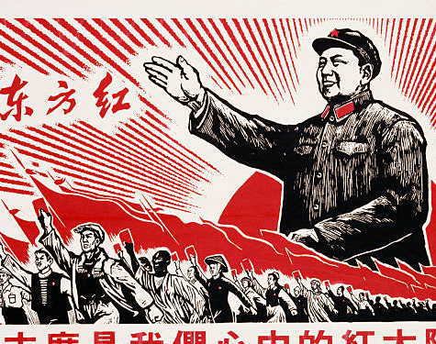
Module 2
The Cultural Revolution (1966-1972)

Slide 2
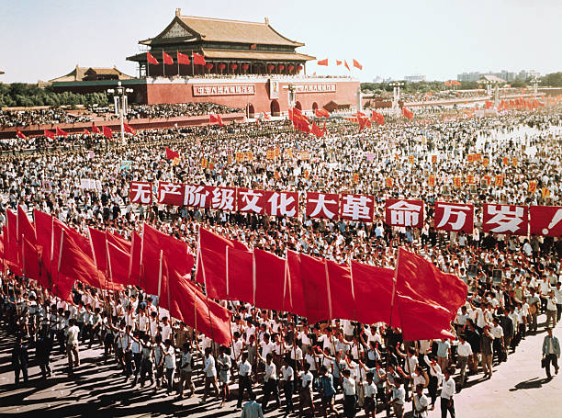
Major Questions:
What was the Cultural Revolution?
Who was responsible for the Cultural Revolution?
What were the origins of the Cultural Revolution?
What were the long-term consequences of the Cultural Revolution?

Slide 3
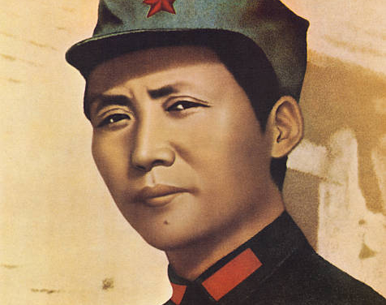
Module 1 Question:
When did the Cultural Revolution begin, who launched it, and Why?
Why did so many Chinese citizens go along with the Cultural Revolution?

Slide 4
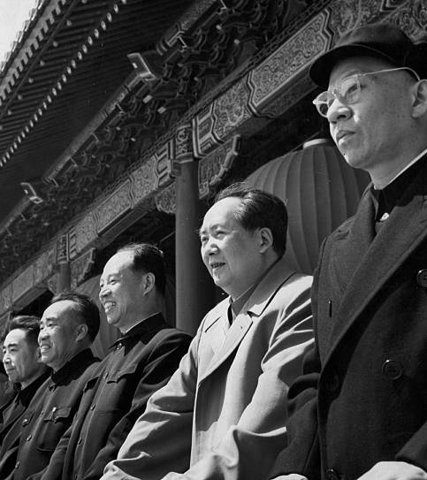
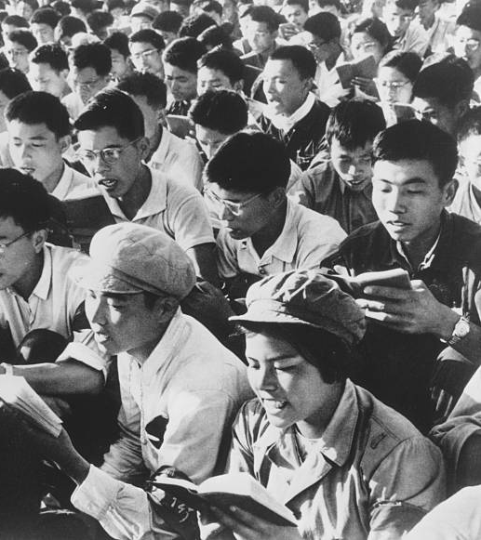
Module Theme:
Political Rivalries & Popular Energy

Slide 5
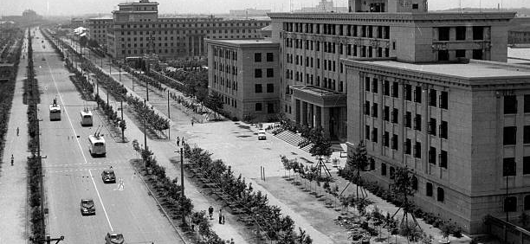
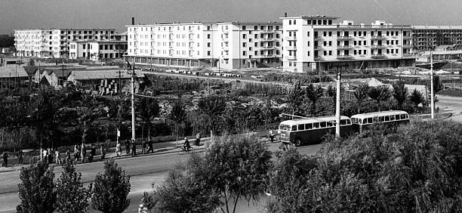
After the Great Leap Forward 1961-1965
Under Liu Shaoqi and Deng Xiaoping
Agricultural Production Bounces Back
Grain Output Up:
193,000,000 (1961) tons to 240,000,000 (1965)
Urban Industrial Production Bounces Back
Industrial Production Up:
11% Growth Rate (Annually)
7% Industrial Employment Growth (Annually)
Productivity Up 5.5 Percent Annually
Cities Grew Quickly, The Countryside Grew Slowly
Healthcare and Education Unevenly Distributed

Slide 6
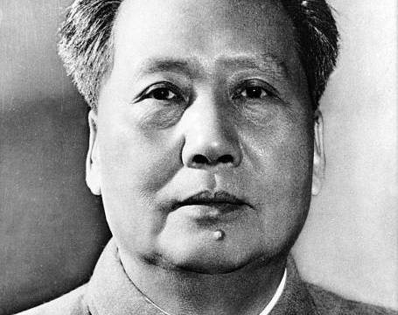
Mao Criticized (1962-1965)?
Angry Mao:
Mao believed he was “treated as a dead ancestor.”
Deng Xiaoping “never came to consult me.” “From 1959 to the present (1966) he has never consulted me over anything at all.”
Critics of Mao:
Wu Han’s Hai Rui Dismissed from Office
A Great Leap Forward play made with Mao’s approval to combat dishonest reporting of output figures. Hai Rui was an honest Ming official who lost his job after challenging a tyrannical emperor.
Jiang Qing and Yao Wenyuan argued the play was an attack on Mao.
Yao Wenyuan: The play misrepresented the history and contained messages that aimed to push people to demolish the people’s communes. “Anyone wanting to overthrow a political regime must create public opinion and do some preparatory ideological work.”

Slide 7
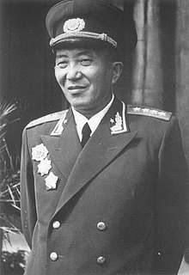
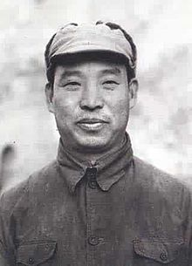
The Cultural Revolution (Phase I): The Political Phase
Begins in 1965-1966 with attacks on Wu Han
Academic to Political
Creation of the Central Cultural Revolution Group
Including Yao Wenyuan & Jiang Qing (Mao’s wife)
Early Purges (1966)
Liu Ruiqing
40 Years as a member of the CCP
Long military and security career
Crimes: Anti-party activity, suicide attempt
Peng Zhen
40 Years of service in CCP
Crime: Accused of being an associate of Wu Han
Politburo Standing Committee
Liu Shaoqi, Zhou Enlai, Zhu De, Deng Xiaoping (fail to intervene)

Slide 8
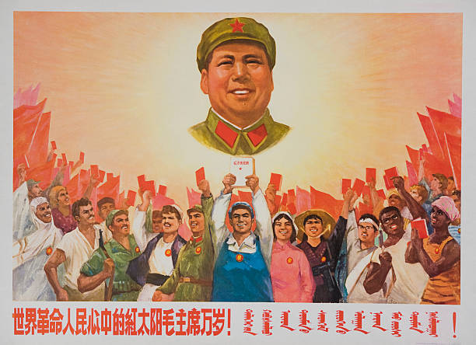
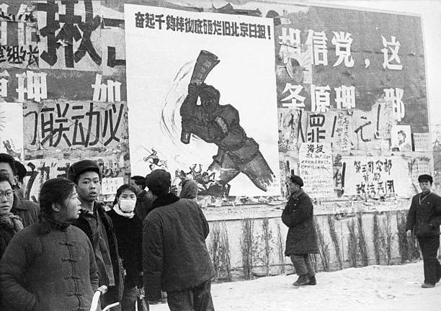
Cultural Revolution (Phase II): The Red Guard Phase
Cultural Revolution first spreads to the people through universities.
May 25, 1966: Nie Yuanzi posts first “big character poster” at Beijing University attacking the university president for suppressing student discussions of the Wu Han affair.
Poster reproduced throughout China
Liu Shaoqi & Deng attempts to “control” the movement with work teams.

Slide 9
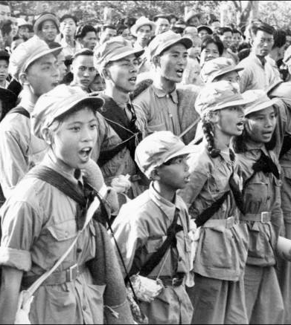
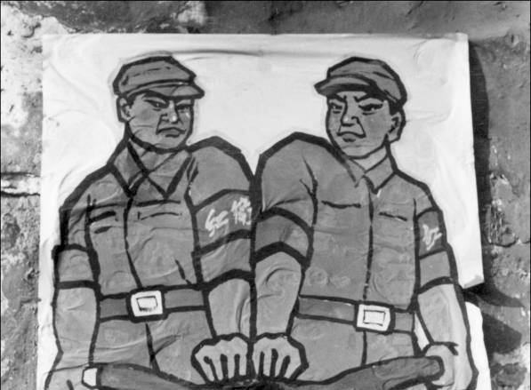
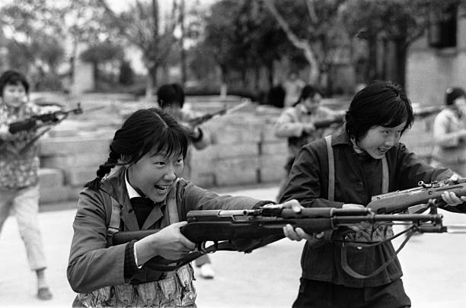
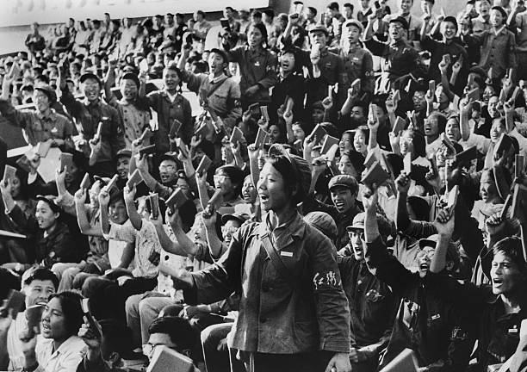
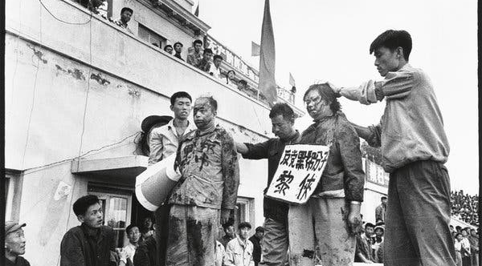
The Red Guard
Bombard the Headquarters (August 1966)
Mao pens letter in support of Red Guard.
But in the last fifty days or so some leading comrades from the central down to the local levels have acted in a diametrically opposite way. Adopting the reactionary stand of the bourgeoisie, they have enforced a bourgeois dictatorship and struck down the surging movement of the great cultural revolution of the proletariat…How poisonous! Viewed in connection with the Right deviation in 1962 and the wrong tendency of 1964 which was ‘Left’ in form but Right in essence, shouldn’t this make one wide awake?
Tens of Millions of Red Guards
“It is justified to Rebel” “destruction before construction”
Free Travel
Destroy the “Four Olds”
Old Ideas
Old Culture
Old habits
Old Customs

Slide 10
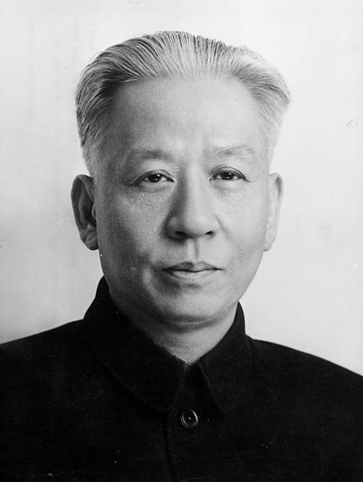
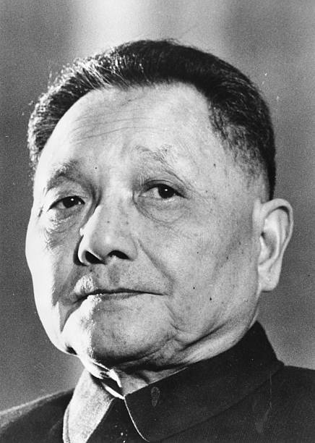
Eliminating Mao’s Rivals (1968-1969)
Mao’s & the Red Guard
Mao maintained loose political and ideological control
Used the Cultural Revolution to attack his rivals
Deng and Liu the most dangerous “capitalist roaders”
Deng Xiaoping deposed sent to work in a tire factory (1969)
Liu Shaoqi was accused of being an “enemy of the people.” He was subsequently denounced, imprisoned, beaten, denied medication. Dies in November of 1969.

Slide 11
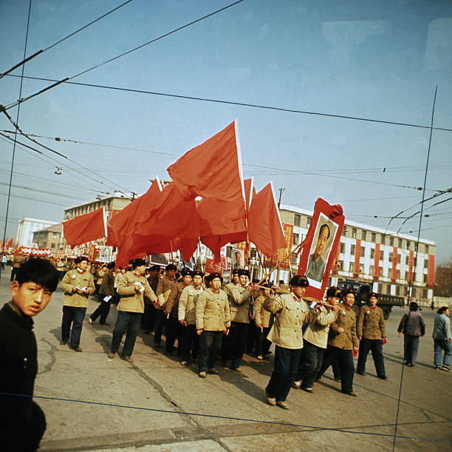
Fate of the Red Guard & Ultra-Leftist
1968 Red Guard suppressed by People’s Liberation Army.
At times involving military engagements
1968 Mao publishes order banishing the Red Guard youths from China’s cities. Between 1968 and 1980, 17,000,000 Red Guard are sent to live in the countryside.
Lost Generation
Many would not return until into the 1980s

Slide 12
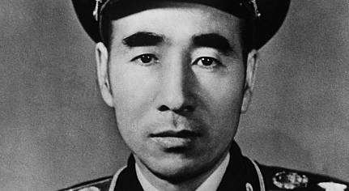

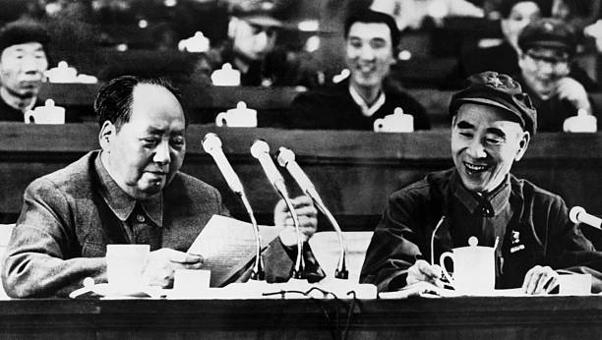
The Fall of Lin Biao
Lin Biao
One of Mao’s most trusted military leaders
Designated Mao’s successor
Key player in building Mao’s Cult of Personality within the People’s Liberation Army and the country more broadly
Rebuilding the Party
Mao shifts to rebuilding the Chinese Communist Party (1970)
Lin accused of “obstructing” the rebuild, “careerism,” and “conspiracy”
Lin’s Mysterious Death
Lin accused of attempting to assassinate Mao and launching a coup (July 28, 1972)
Killed along side wife and son when his plane crashed over Mongolia.

Slide 13
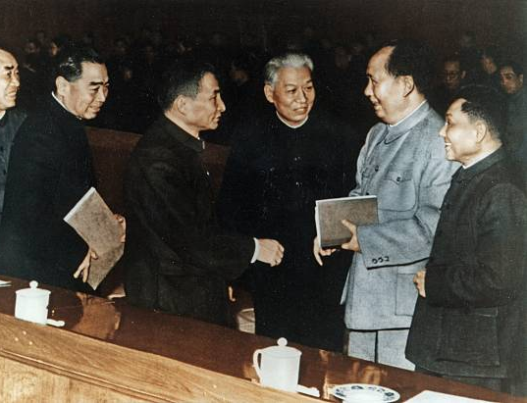
The Cultural Revolution through 1972
Mao’s weapon to “revive” the Chinese Revolution & Neutralize his rivals.
3,000,000 party and government officials lost their jobs.
500,000 people killed or committed suicide.

Slide 14
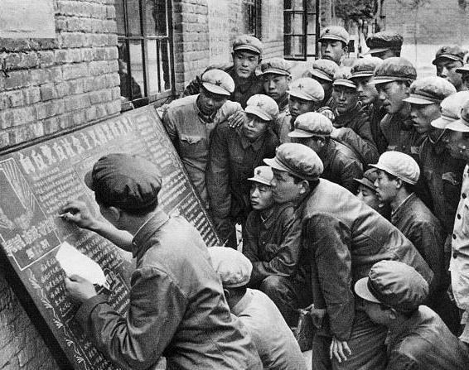
Question Review
What was the Cultural Revolution?
Who was responsible for the Cultural Revolution?
What were the origins of the Cultural Revolution?
What were the long-term consequences of the Cultural Revolution?
Module Questions
When did the Cultural Revolution begin, who launched it, and Why?
Why did so many Chinese citizens go along with the Cultural Revolution?

